Slide 3
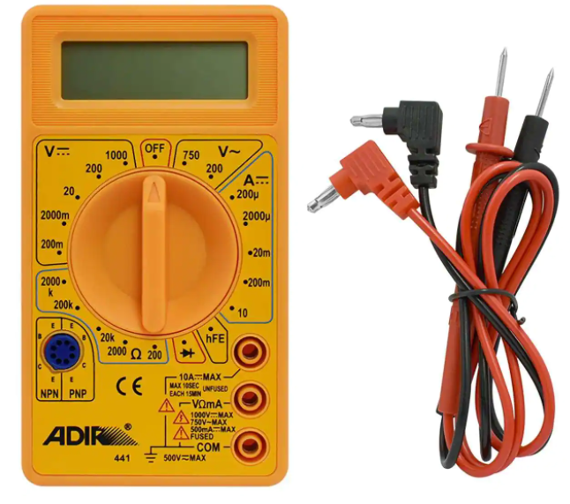
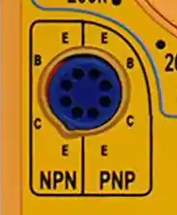

Slide 8
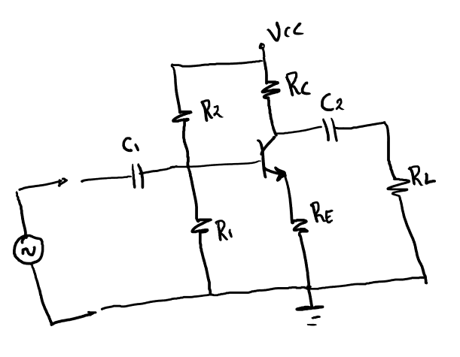

Slide 11
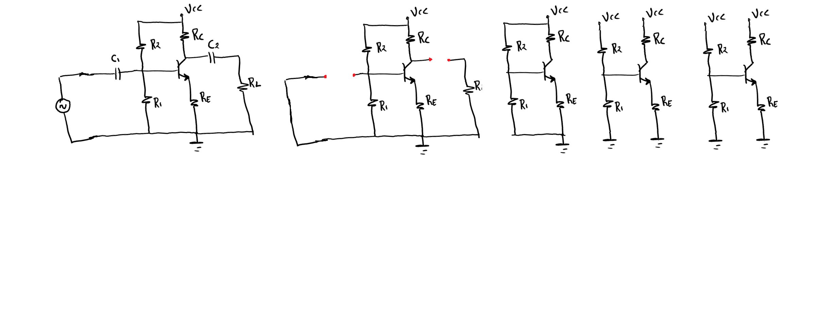

Slide 12
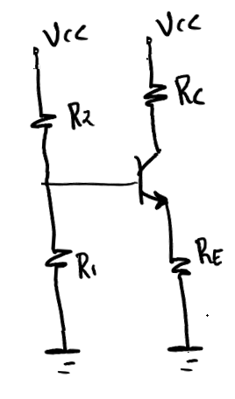
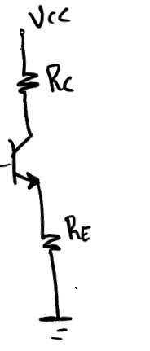

Slide 14
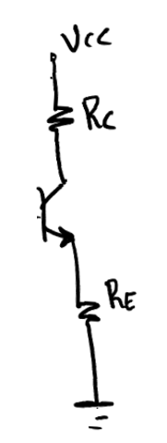

Slide 15
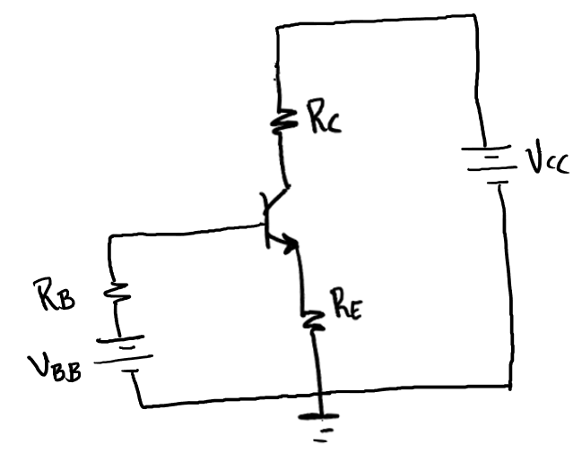

Slide 18
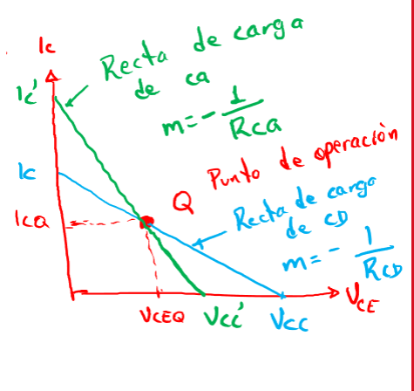

Slide 19
clear; clc;
RC=input('RC: ');
RE=input('RE: ');
RL=input('RL: ');
R1=input('R1: ');
R2=input('R2: ');
VCC=input('VCC: ');
beta=input('Beta: ');
RB=(R1*R2)/(R1+R2);
VBB=(VCC*R1)/(R1+R2);
ICQ=(VBB-0.7)/((RB/beta)+RE);
VCEQ=VCC-ICQ*(RC+RE);
RCD=RC+RE;
Rca=((RC*RL)/(RC+RL))+RE;
Vccca=VCEQ+ICQ*Rca;
IC=VCC/RCD;
icca=Vccca/Rca;
hold on
plot([0 VCC],[IC 0],'b')
plot([0 Vccca],[icca 0],'g')
plot([0 VCEQ],[ICQ ICQ],'--k')
plot([VCEQ VCEQ],[0 ICQ],'--k')
plot(VCEQ,ICQ,'xr')

Slide 21
